Slide 1
ict-research.nl
We represent scientific researchers in ICT

Slide 2
ICT-Research Platform Netherlands
We represent scientific researchers in ICT
https://ict-research.nl
ipn@nwo.nl

Slide 3
Who we are
IPN is a platform that unites scientists in the academic ICT field and acts as the authority when it comes to questions regarding future demands and possibilities of ICT science and how to prioritise research in this field.

Slide 4
What we do
IPN unites, strengthens and advocates academic research and education on ICT in The Netherlands, to help realise high-quality digitalisation agendas that enable society to face the ICT challenges of today and tomorrow.

Slide 5
Our way of working
IPN builds and maintains a national community, and develops policy to advance the field. The platform actively enhances diversity in ICT by stimulating the participation of women and minorities. IPN advocates the importance of ICT for our current society.

Slide 6
Organisation (current)
Normal members: in principle, each university that has an organisational unit associated with ICT science, jointly covering most academic ICT scientists in The Netherlands
RU, RUG, RUL, TiU, TUe, TUD, UT, UU, UvA, VU, WUR
CWI, EE-NL
Special members:
Every organisation with a strong ICT-research component, but is not exclusively focused on ICT: NLeSC, SURF, TNO
National ICT-research schools: ASCI, IPA, SIKS
Special ICT interest groups: data science (DSPN), cybersecurity (dcypher), software engineering (VERSEN), data in life sciences (DTLS), mathematicians (PWN)

Slide 7
Organisation (current)

Slide 8
A united community, a united voice
Acting
Community building
Policy building
Reacting

Slide 9
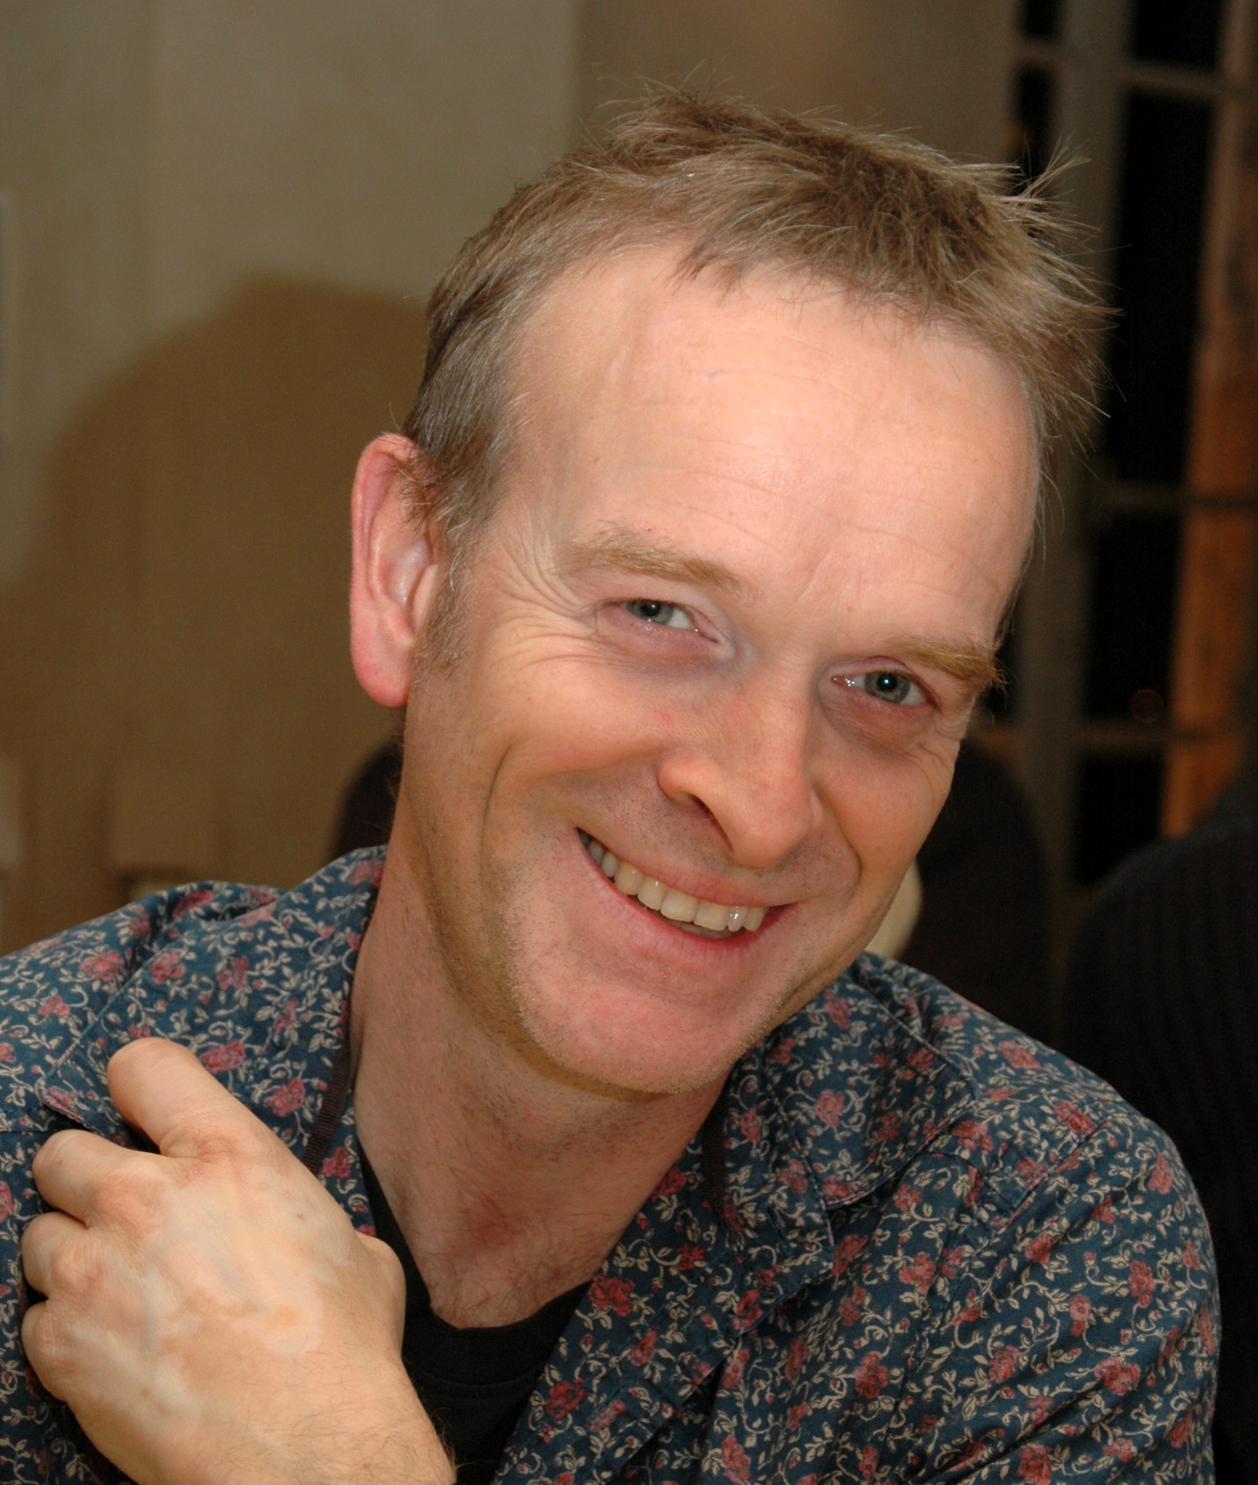
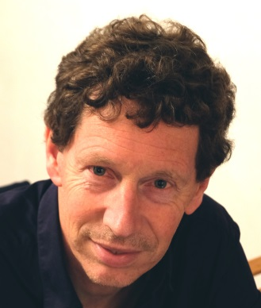
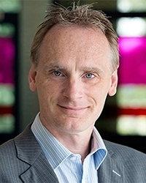
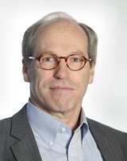
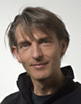
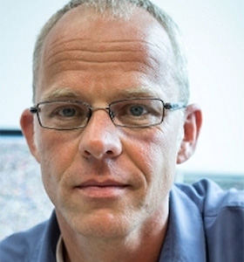
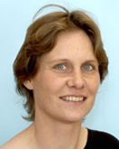
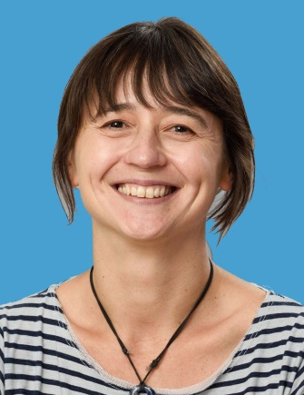
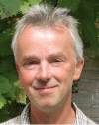
UvA
VU
UL
TUD
TiU
Alfons Hoekstra
Frank van Harmelen
Aske Plaat
Dick Epema
Erik Postma
Marcel Worring
Annette ten Tije
Anna Vilanova
Hans Weigand
IPN Representatives

Slide 10
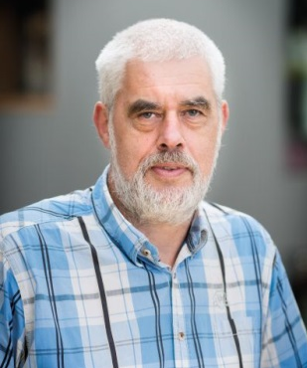
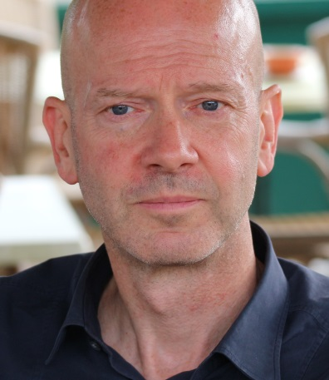
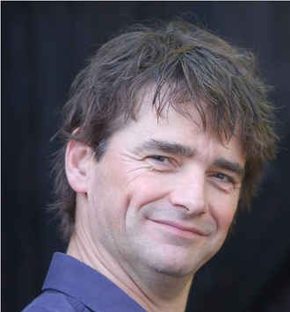
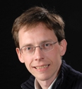
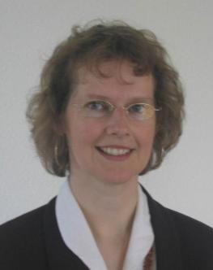
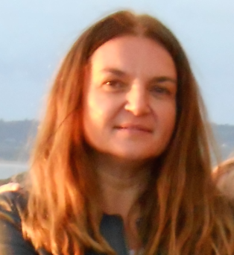
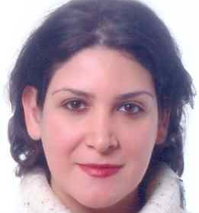
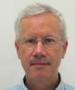
TUE
UU
RU
UT
RUG
Johan Lukkien
Johan Jeuring
Herman Geuvers
Jaco van de Pol
Rineke Verbruggen
Bettine Spekmann
Slinger Jansen
Lejla Batina
Nirvana Meratnia
Jos Roerdink
IPN Representatives

Slide 11
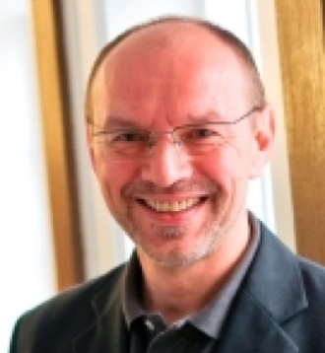
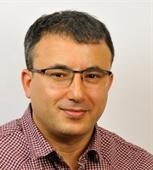
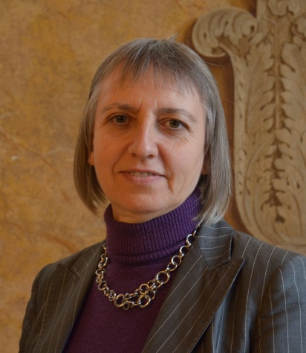
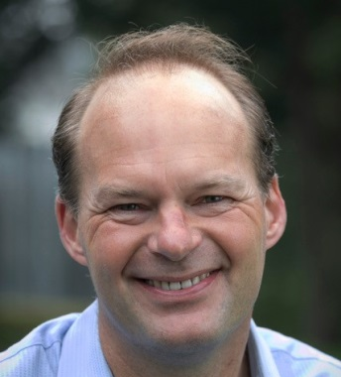
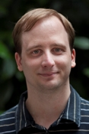
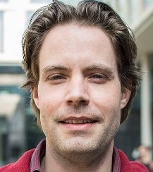
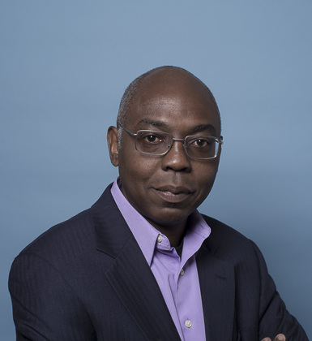
UM
WUR
CWI
EE
Gerhard Weiss
Bedir Tekinerdogan
Lynda Hardman
Bram Nauta
Mark Winands
Thijs van der Storm
Kofi Makinwa
IPN Representatives

Slide 12
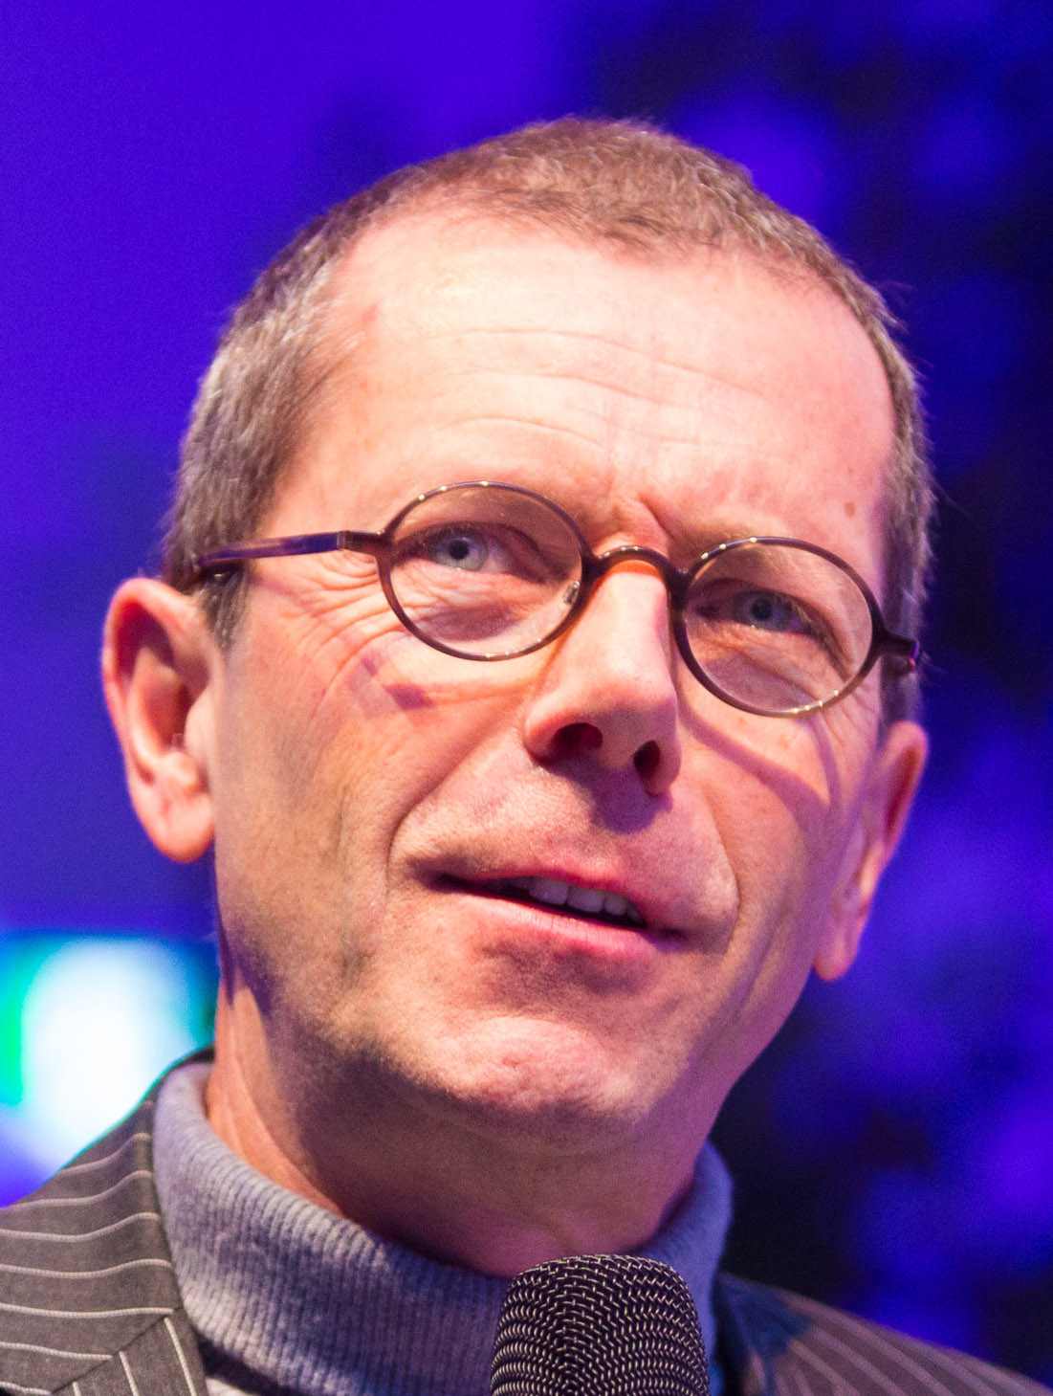
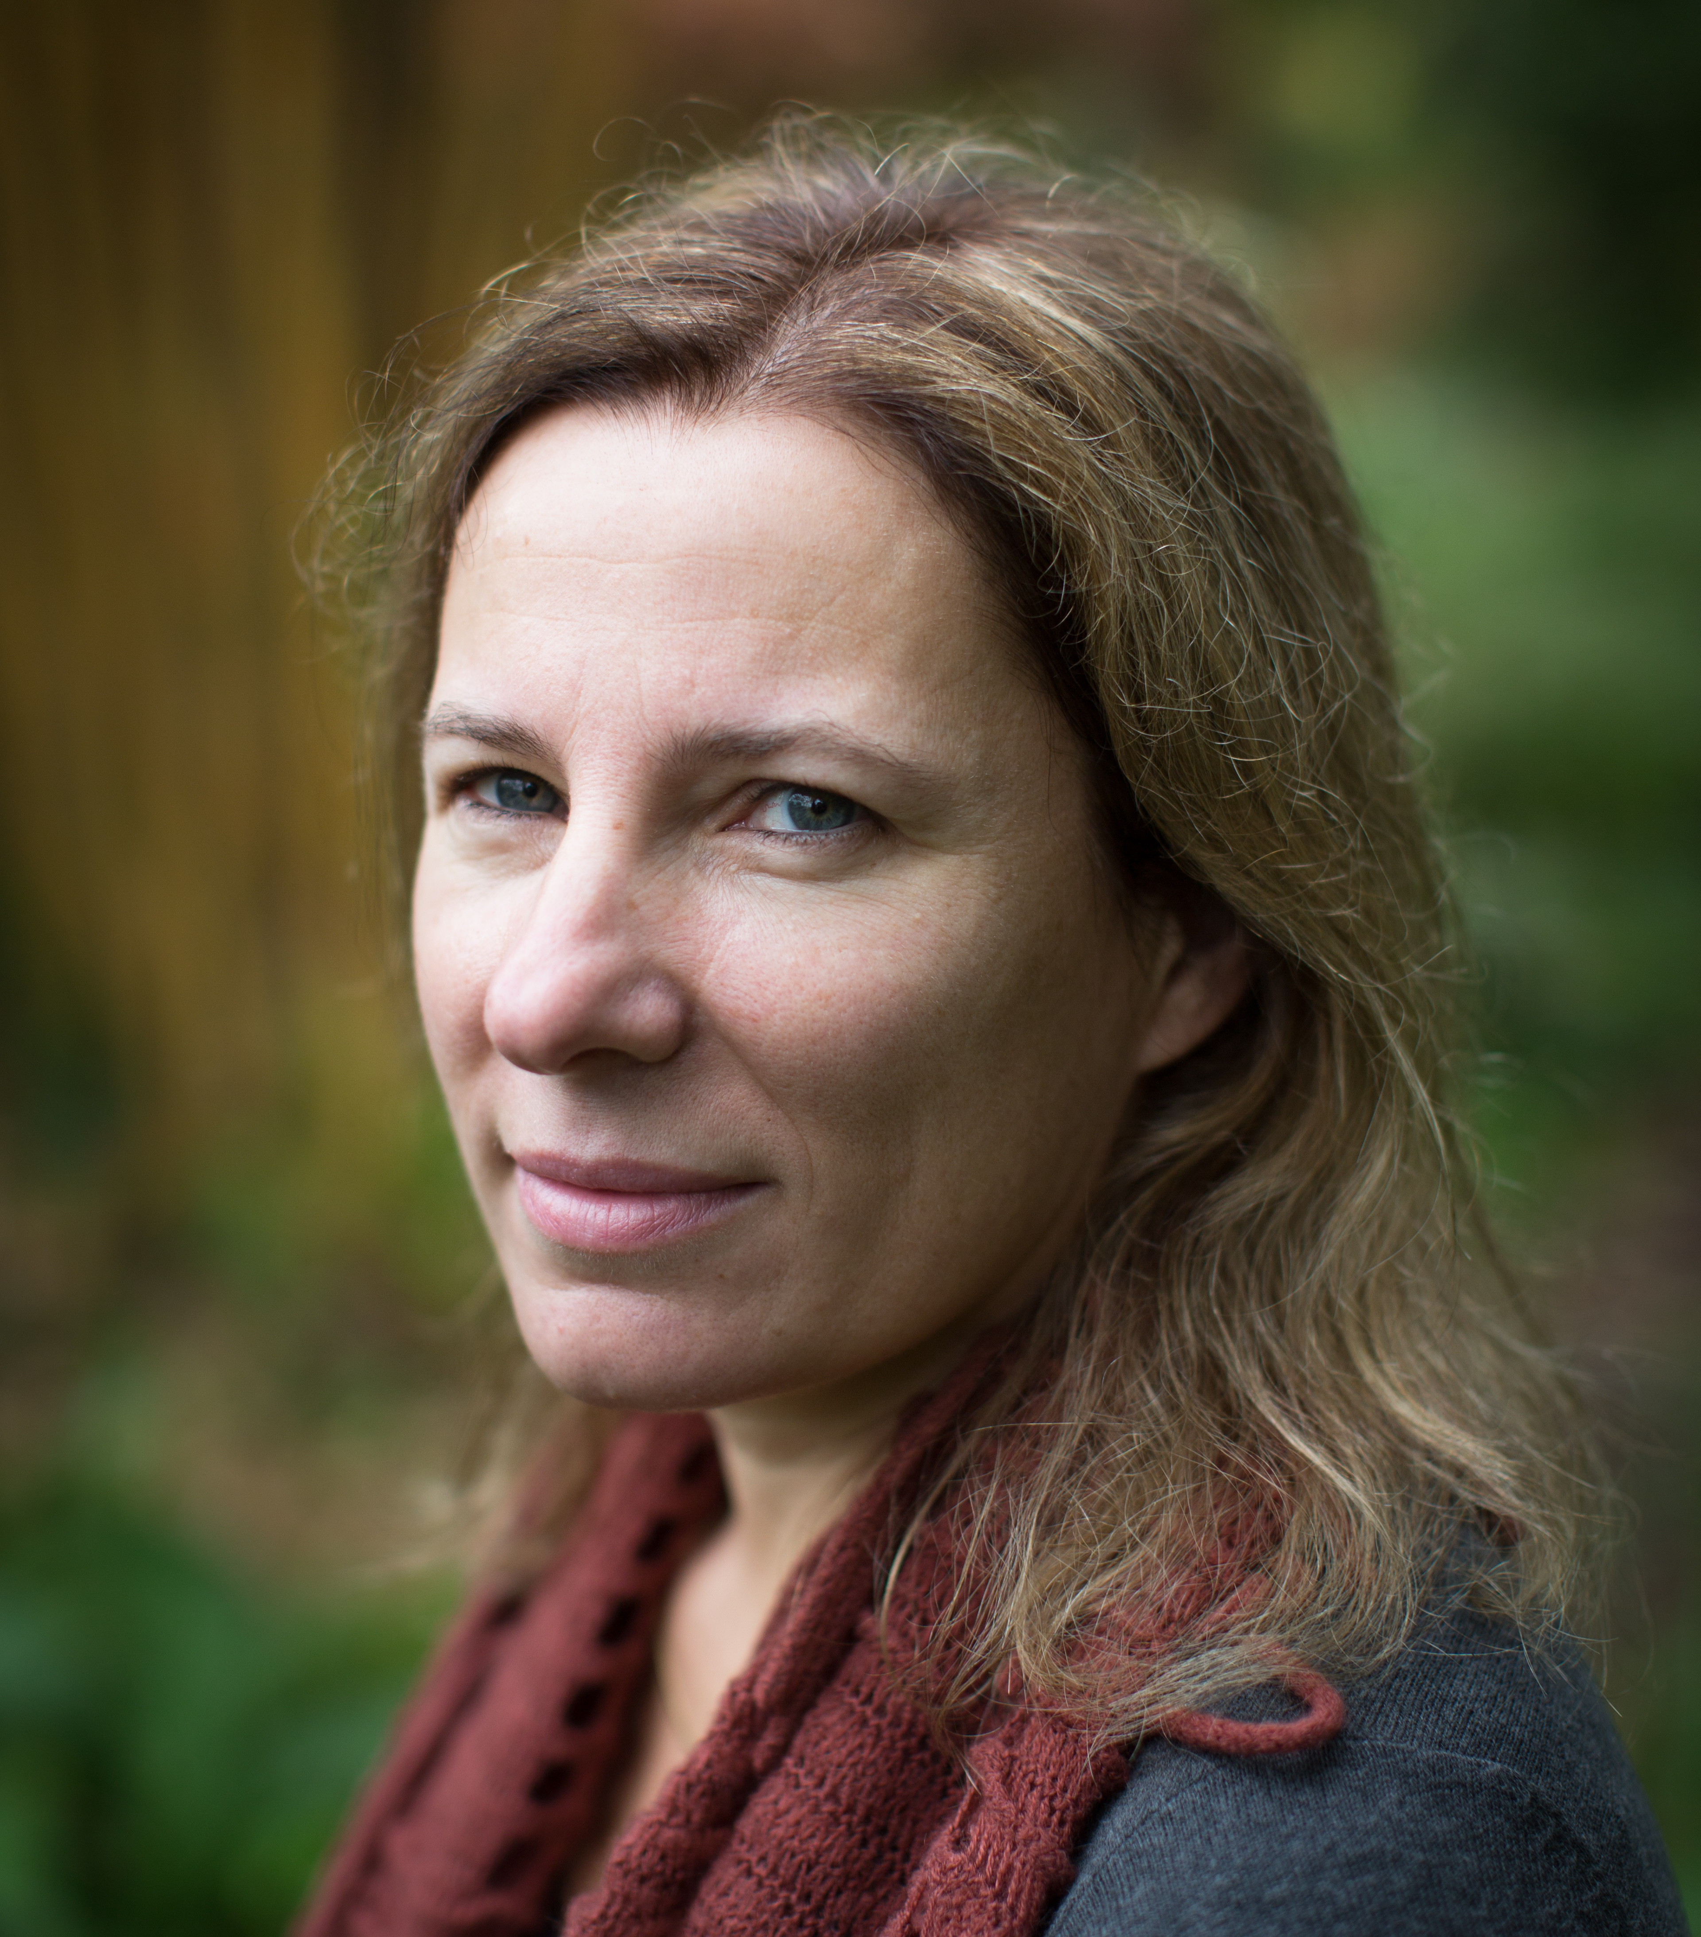
Maarten van Steen (chair)
Patricia Lago
Gerard Barkema
John Jules Meyer
Board members
IPN Representatives

Slide 13
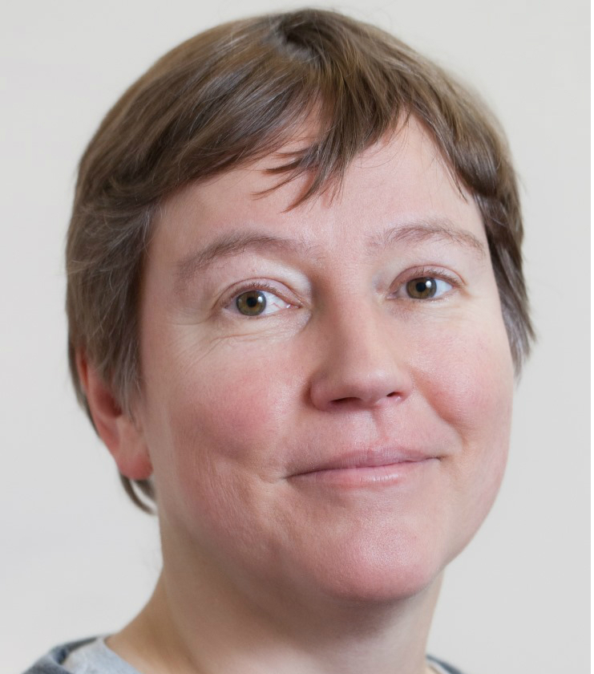
NWO-ENW Round Table Informatics
Maarten van Steen (chair)
Patricia Lago
Herbert Bos
Franciska de Jong
Lynda Hardman
Tom Heskes
Catholijn Jonker
Inald Lagendijk
Josien Pluim
Mark van den Brand
Jos Roerdink

